Slide 1
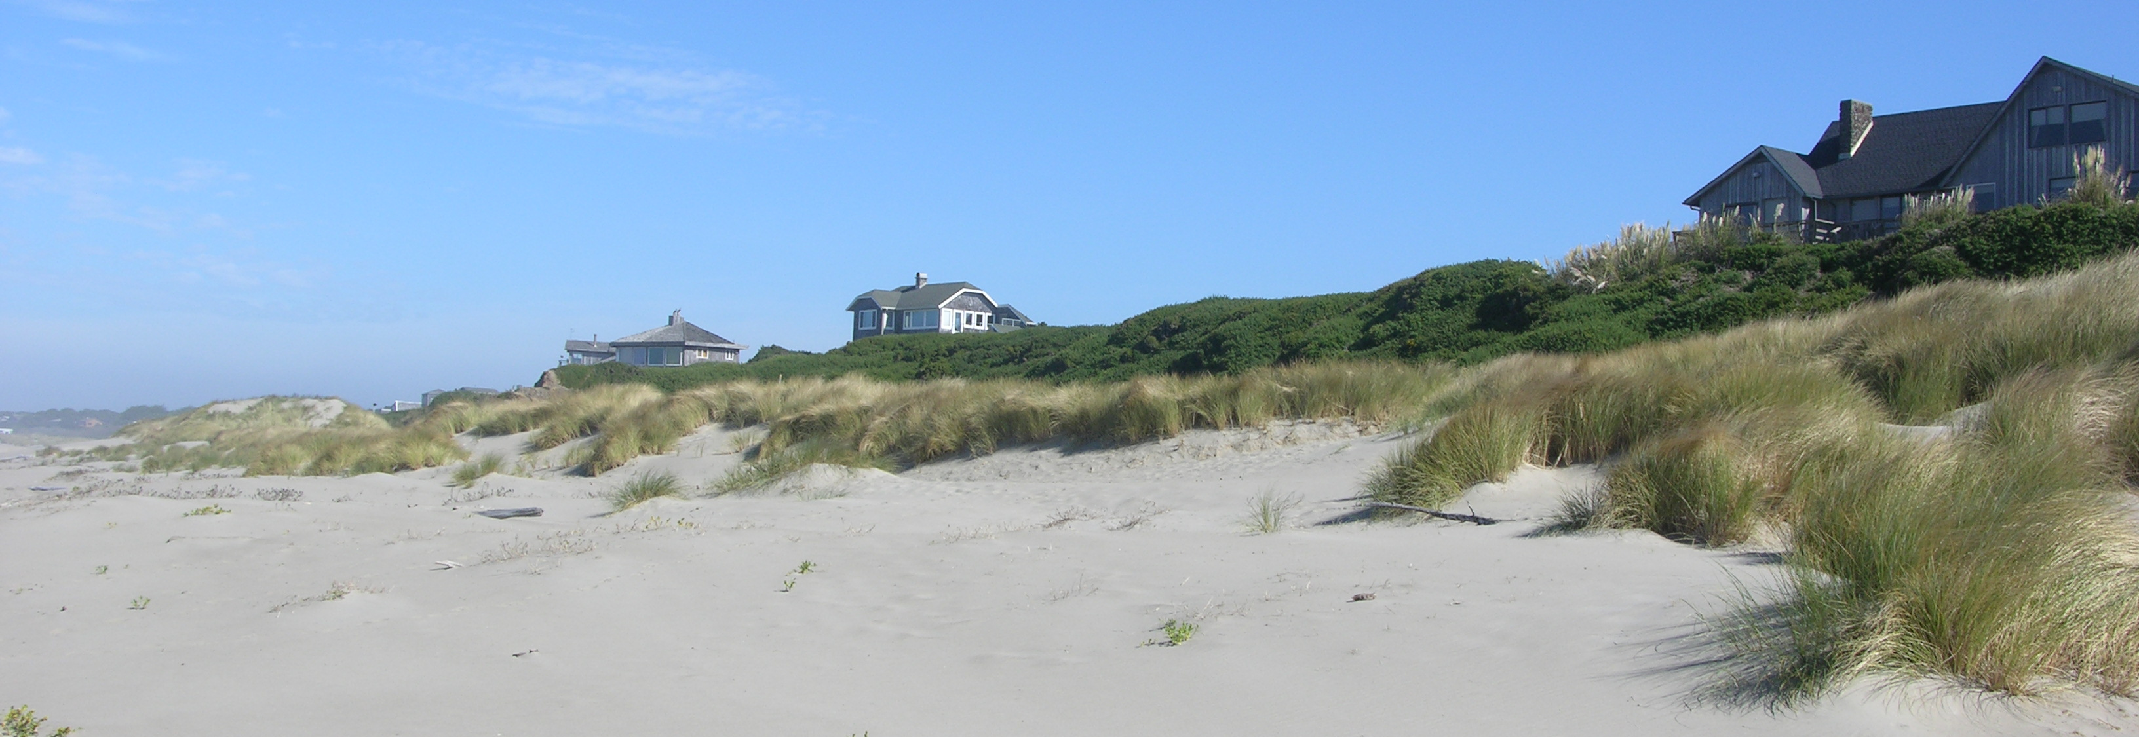
Coos County Beaches and Dunes Inventory Map Updates
Coos County Planning Commission Meeting and Work Session
August 7th, 2025
Rhiannon Bezore
Coastal Shores Specialist, DLCD
rhiannon.bezore@dlcd.oregon.gov

Slide 2
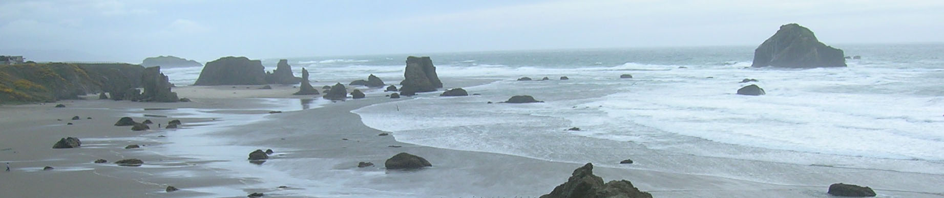
Statewide Planning Goal 18: Beaches & Dunes
Guides the protection and development of beach and dune areas
Main provisions:
Prohibition areas for development
Preservation of dune vegetation
Dune grading requirements
Beachfront Protective Structure (BPS) limitations
Inventory of beach and dune areas
Inventories shall describe:
Stability
Movement
Groundwater resources
Hazards
Values
Notes:
Importance of the goal – balancing public beach protection with development and private property protection
Goal 18 is central to the work of coastal communities in addressing the impacts of climate change and coastal hazards in areas along the ocean shore; of particular importance are Implementation Requirement 2, 5, and 7.
Implementation Requirement 2 prohibits development on the most sensitive and hazardous landforms in the beach and dune environment, including beaches, active foredunes and other dune areas subject to severe erosion or flooding. This requirement has been instrumental in preventing inappropriate development on these critical landforms. It is noteworthy that many of the most problematic current beach and dune management issues are the result of development that occurred on these landforms prior to Goal 18 implementation; the very type of development IR 2 now operates to prevent.
Implementation requirement 5 limits shoreline armoring. Shoreline armoring cons – limits beach access, alters landscape, breaks the link between terrestrial and aquatic ecosystems, disrupts sediment cycles, aesthetics. Permitting via OPRD, sometimes local gov
Implementation requirement 7 specifies detailed requirements for the management of foredune grading. Such grading is permitted in limited circumstances in association with existing development. It must be based on a specific dune system management plan that prescribes standards for maintaining flood protection, maintaining overall system sand supply, and post-grading sand stabilization. There are currently six acknowledged dune management plans in place in Oregon. (It should be noted that limited “remedial” grading to clear sand encroaching on structures is permissible without the necessity for a dune management plan.)
Dunes provide a lot of important values to ecosystems and human communities
When Goal was initially written, view grading was prohibited. However, illegal dune grading continued to happen so our commission decided to find a compromised approach that allowed view grading under prescribed circumstances that allowed the preservation of the dunes integrity. The goal was revised in 1984 to integrate these new recommendations.

Slide 3
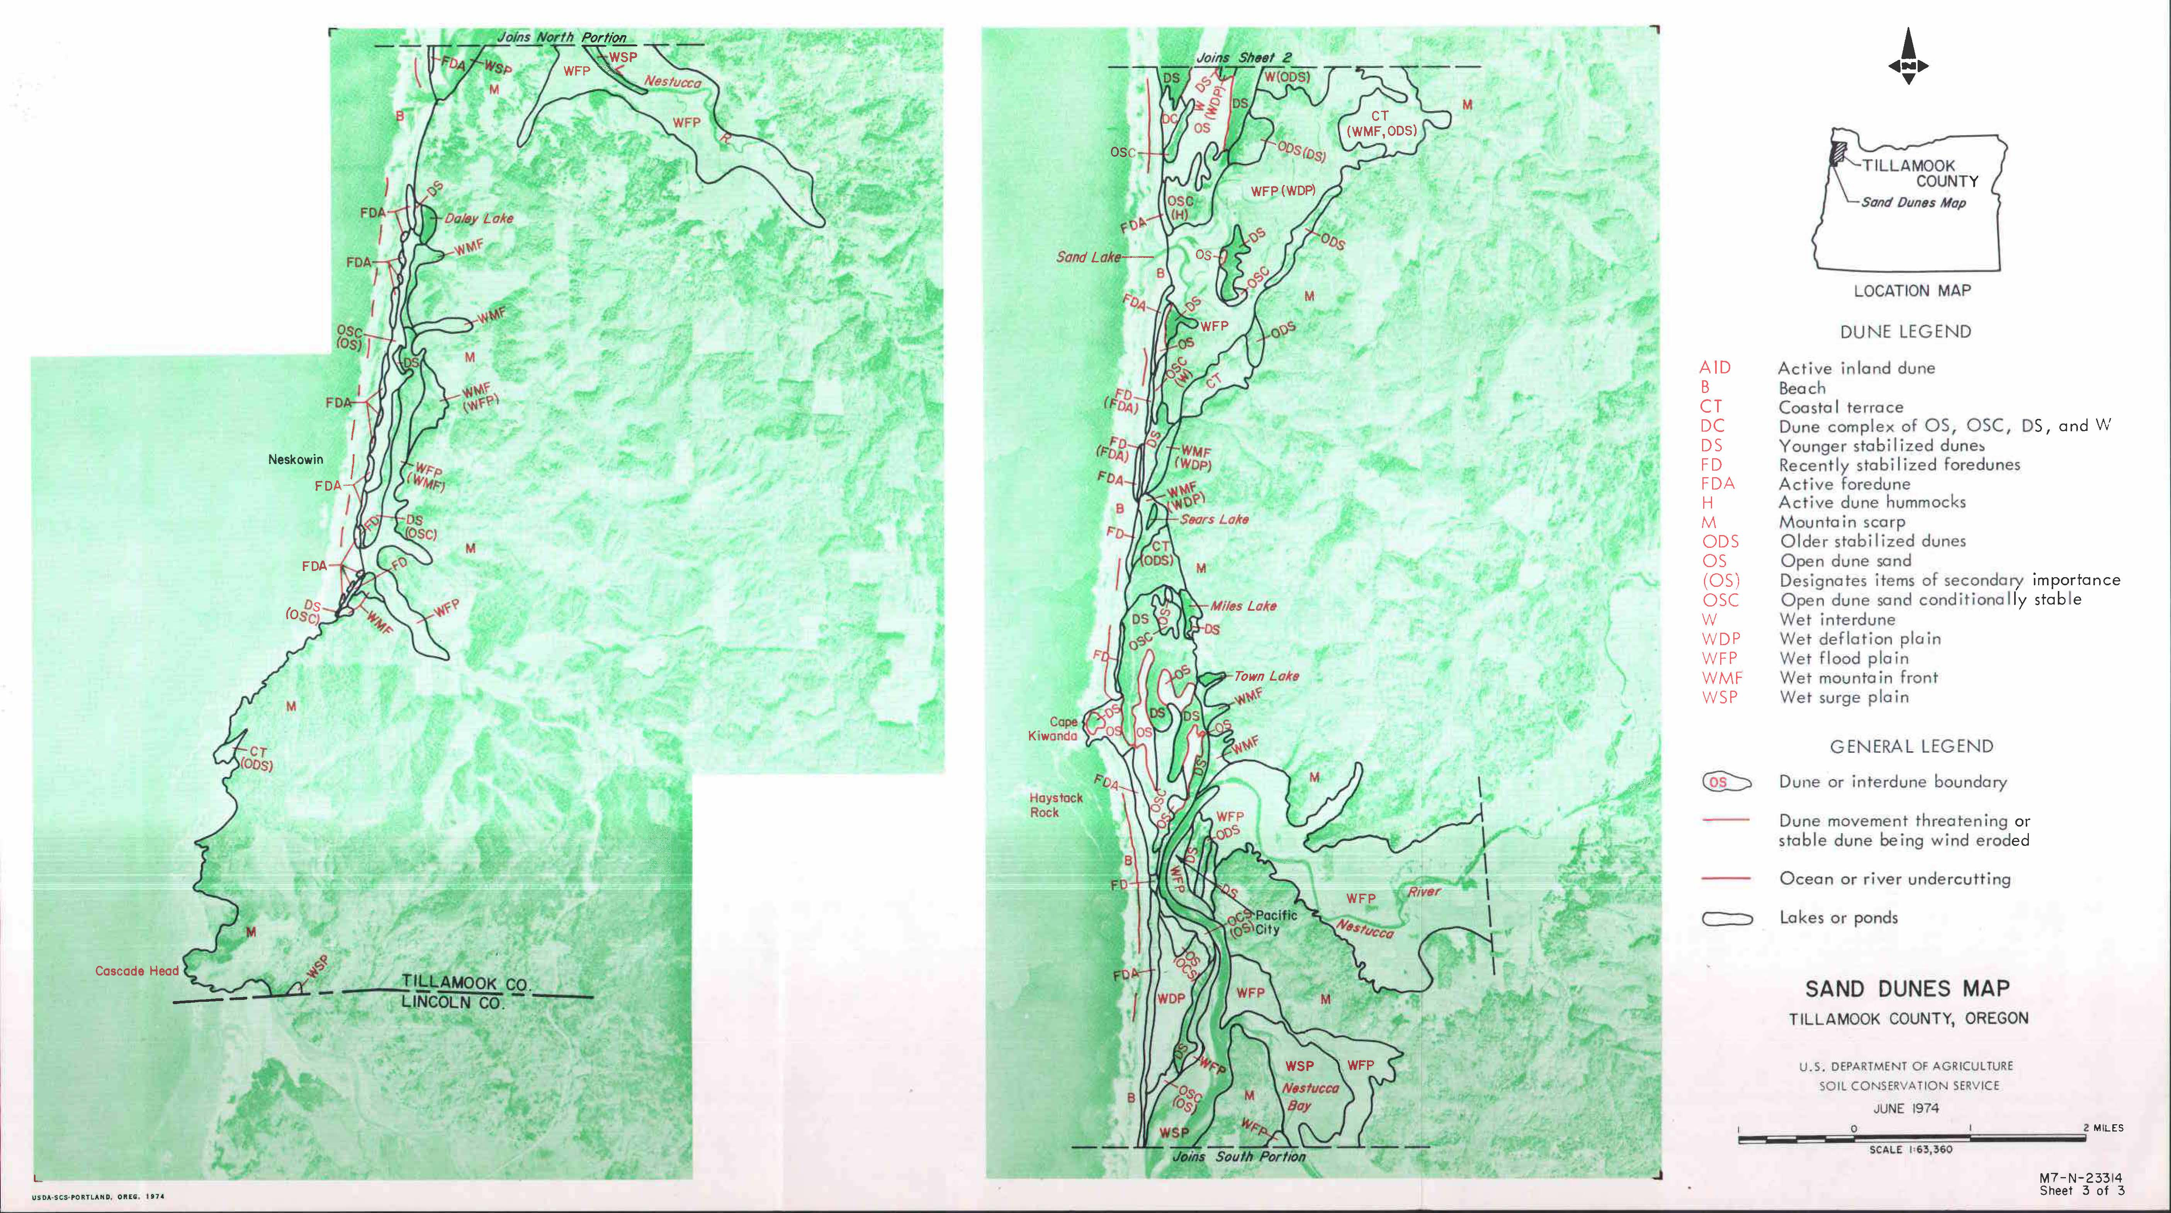
Maps from 1975, still in use
Notes:
New beach and dune inventory mapping efforts underway by DOGAMI

Slide 4
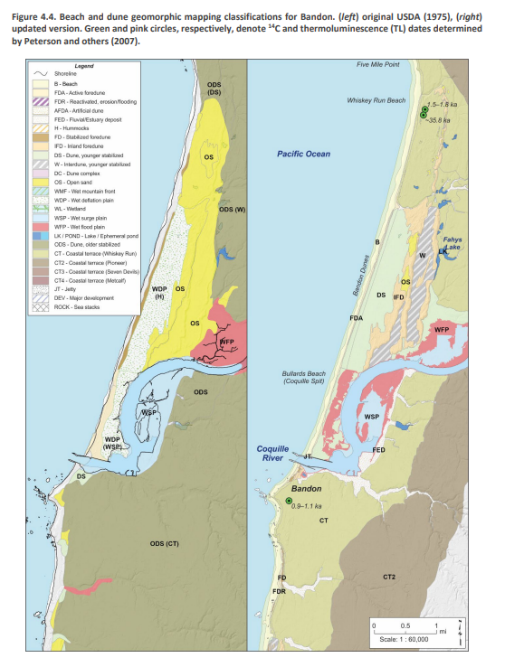
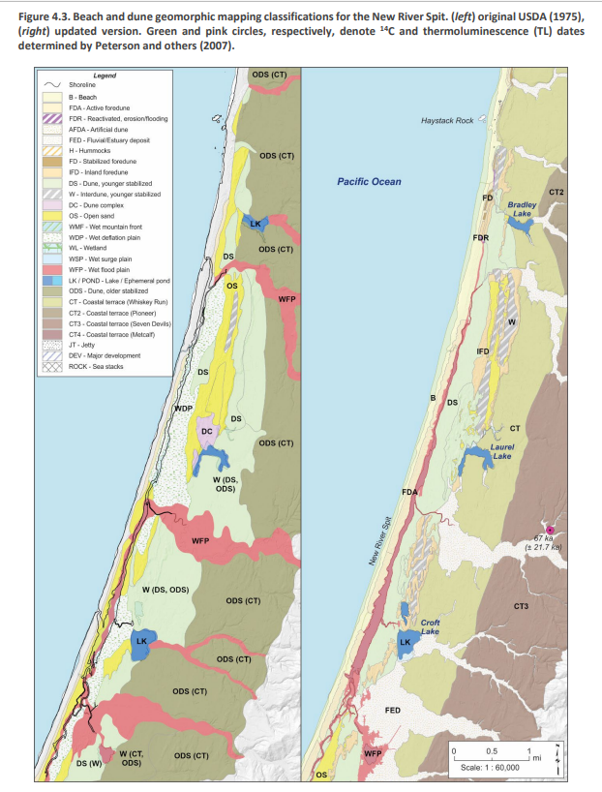
https://pubs.oregon.gov/dogami/ofr/O-24-13/O-24-13-report_.pdf
New Maps Created by DOGAMI- 2024

Slide 5
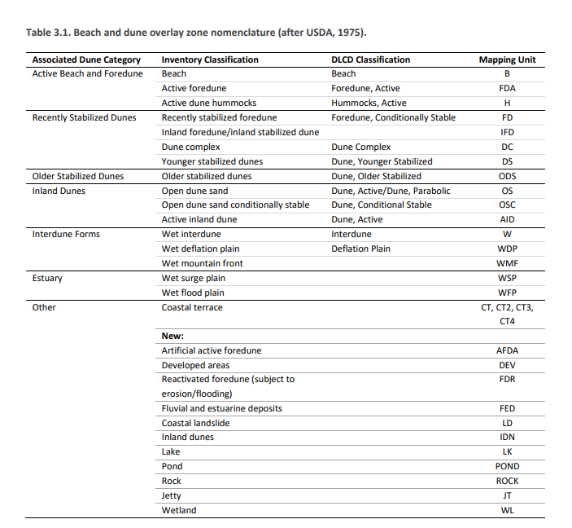
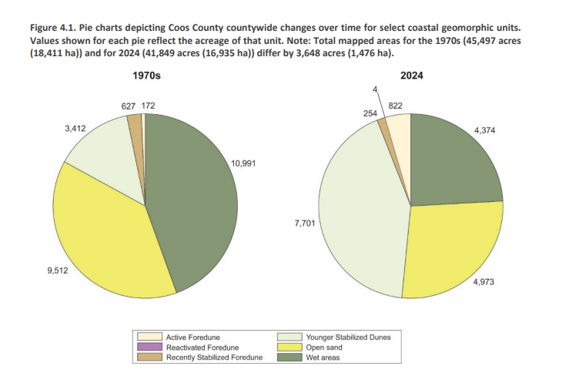
New maps reflect changes in conditions over time, updated technology for mapping, and include new classifications

Slide 6
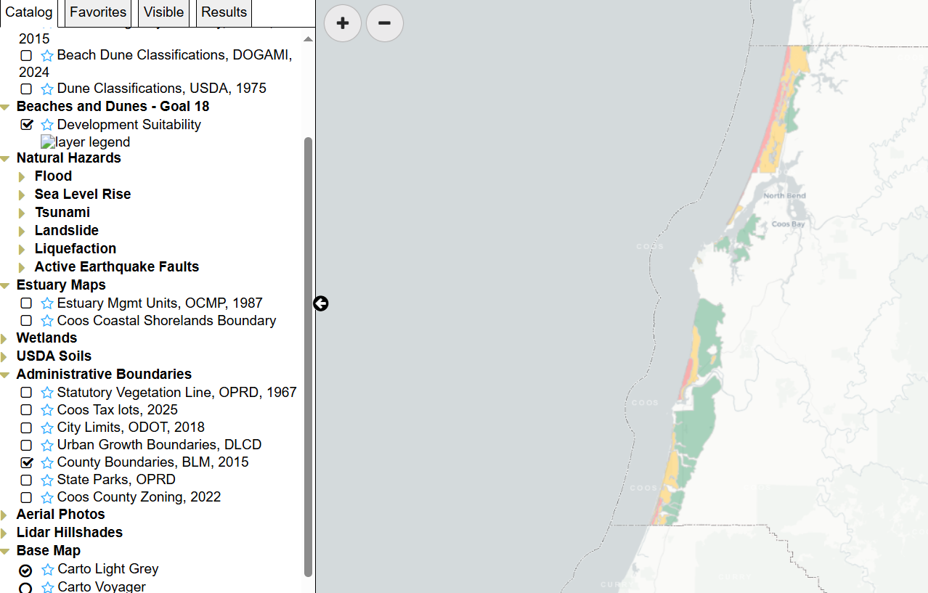
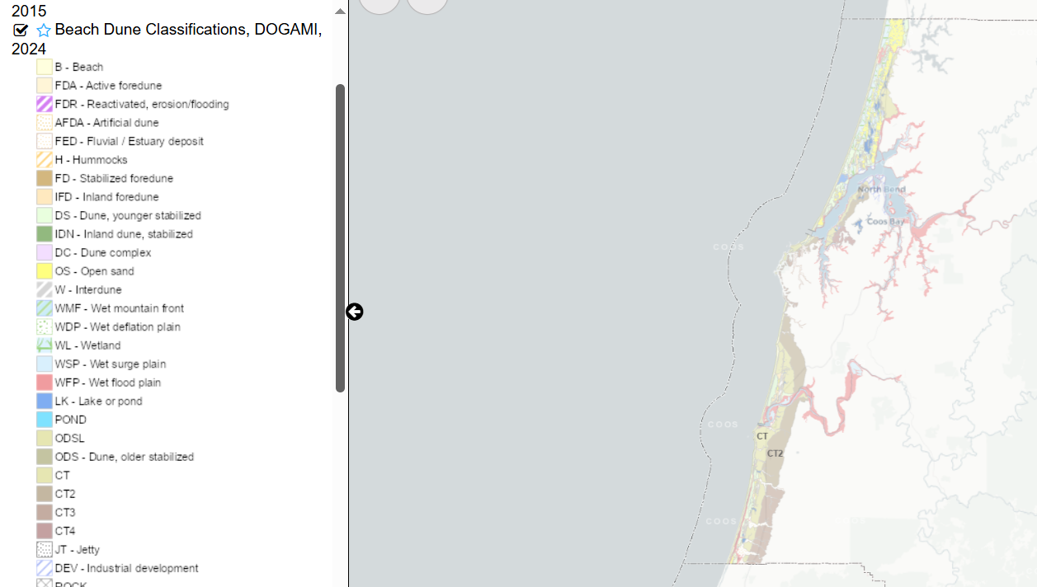
Coos County All Hazards Viewer www.coastalatlas.net/coos-all-hazards/map/

Slide 7
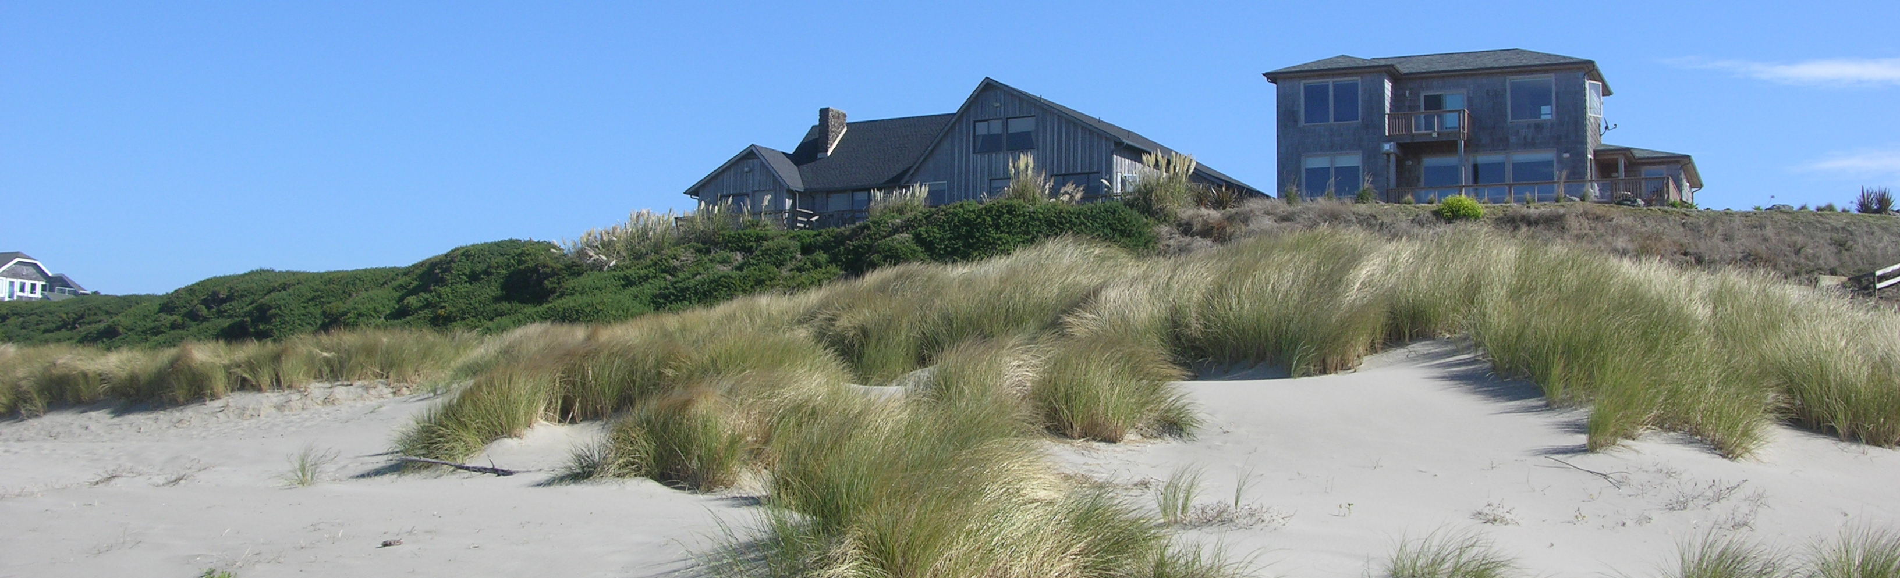
Goal 18 Updates
Model language from DLCD
County-specific needs addressed
Updates reflect new maps and changing conditions
Sea level rise, coastal hazards
Reflect best practices for dune grading, limiting armoring, vegetation management

